Slide 1
SG DIGITAL CONTENT STUDIO
Studio Asset and Space Booking
An app to book studio space and equipment, with the request, approval and return process automated.
Niharika Karanam
Internship project — UX, Power Platform build, automation

Slide 2
BACKGROUND
The current process, and what the app needed to do
HOW IT WORKS TODAY
WHAT THE APP NEEDED TO DO
Studio space is booked through the Outlook room scheduler.
Assets are requested informally or by email.
Assets are returned after the shoot and roughly inspected for damage.
A rough asset list exists, but it is not available for users to browse.
No data or documentation on bookings, assets borrowed or returns.
Show the asset list and bundles, so users can see what the studio has.
Show availability in the booking page.
Let users cancel their own booking.
Keep the admin approving or declining — a human in the loop.
Send automated emails at every stage of the booking.
Document returns, so asset condition is accountable.
Record booking data that can guide future asset purchases.

Slide 3
APPROACH
Platform and prototyping
Why Power Apps
Outlook email automation
Booking, approval, decline and cancellation emails send automatically.
CONSTRAINT
AI-assisted building is disabled on Power Apps at organisation level.
Calendar event creation
An approved booking creates an invite for the user and the studio.
Microsoft Lists for data
Bookings, assets, bundles, return issues and admins each in a list.
Every screen and interaction in the live app was created manually and coded with Microsoft fx.
Data safety and sharing
Data stays in the Nestlé environment, and the app is easy to share.
Prototyping before building
01
02
03
04
Figma
GitHub
Codex and Claude
Power Apps
Prototype built with AI to reach interactive screens quickly.
Moved to a repository once the Figma credits ran out.
Almost a functional app, with no data or automation.
Only the tested design was rebuilt manually.
Notes:
Prototyping first mattered because the live build is entirely manual. Also mention, if asked, that the Claude MCP connector to Power Platform was tested separately on a personal computer and school account, with unconvincing results.

Slide 4
02
User testing and feedback
Four rounds of feedback on the prototype, and what changed as a result.

Slide 5
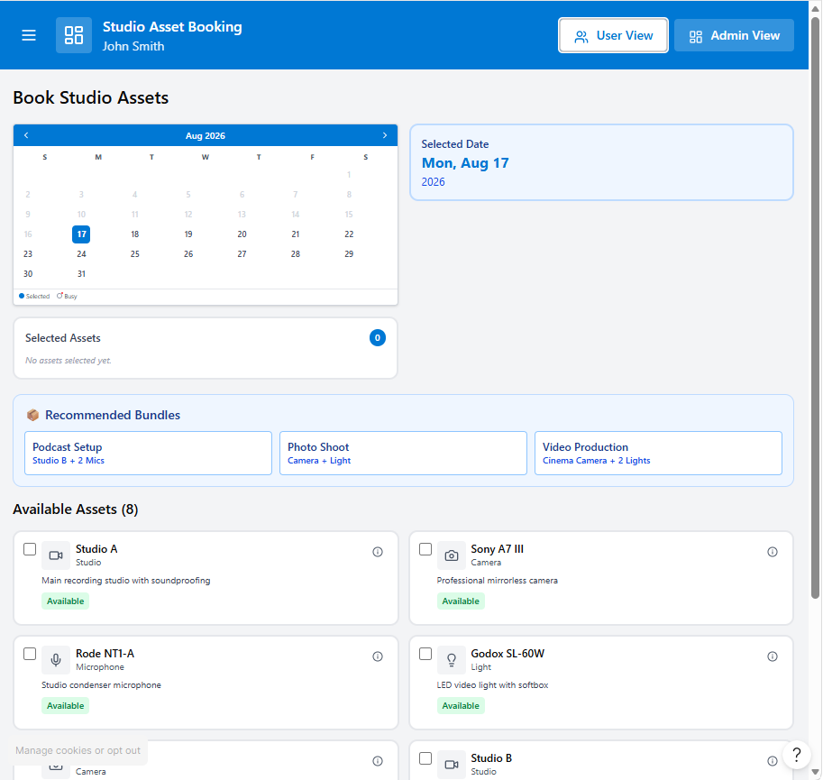
USER TESTING 01
Booking calendar and asset selection
Feedback
Users did not appreciate a month-long preview of unavailable dates.
Users did not look at the selected assets at the top of the page.
Users rarely selected the bundles, and the assets needed better organisation.
ACTION
The calendar was changed to a standard dropdown. Selected assets and bundles were moved to the bottom, as it was more intuitive to have them in the final check, after browsing all assets.
Before

Slide 6
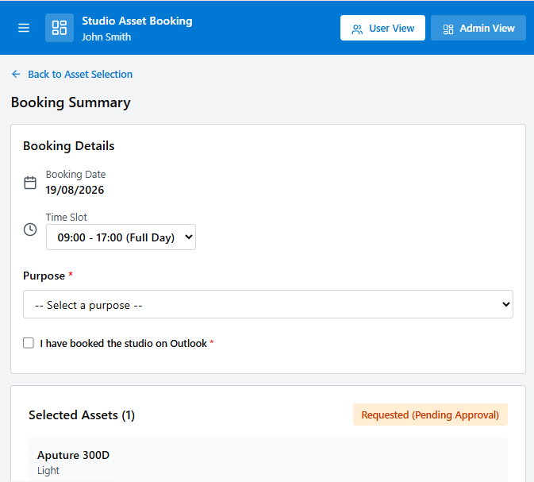
USER TESTING 02
Booking summary and time slots
Feedback
Time slots were set to AM, PM or Full Day rather than hourly, because time also needs to be accounted for returning assets.
Studio booking in Outlook goes through an approval process, and I do not have access to the room booking API.
ACTION
A direct link to the Outlook page with the studio email address was added. Two separate options were given from the start, for people who only want assets and people who need both studio space and assets.
Before

Slide 7
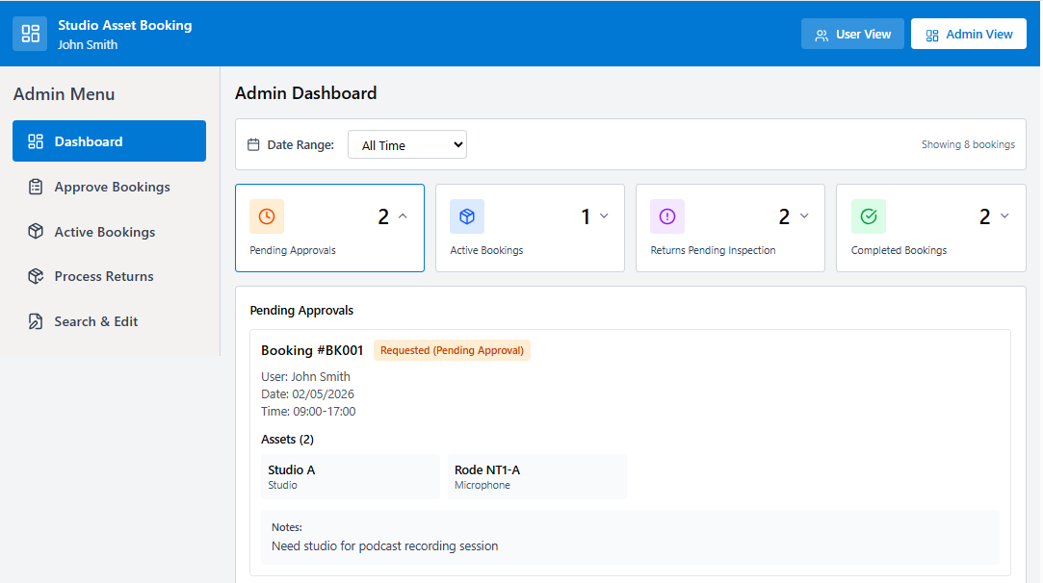
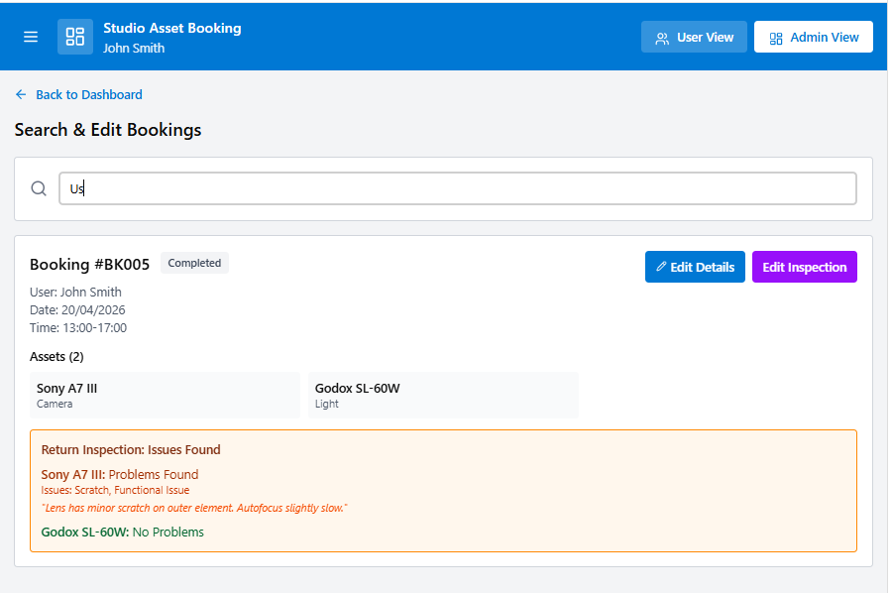
USER TESTING 03 AND 04
Admin screens
Admin menu and dashboard
Search and edit bookings
The admin menu and admin dashboard had duplicate screens showing similar information in a different way.
Editing booking details and editing return details were separate buttons, and both were shown even after the item had been returned.
ACTION
ACTION
Simplified to four screens reachable from both the dashboard and the side panel: approve bookings, active bookings, and process returns, with search and edit in the dashboard page.
Changed to one button that edits both booking and return details.

Slide 8
03
Redesign after user testing
The changes above, applied to the app.

Slide 9
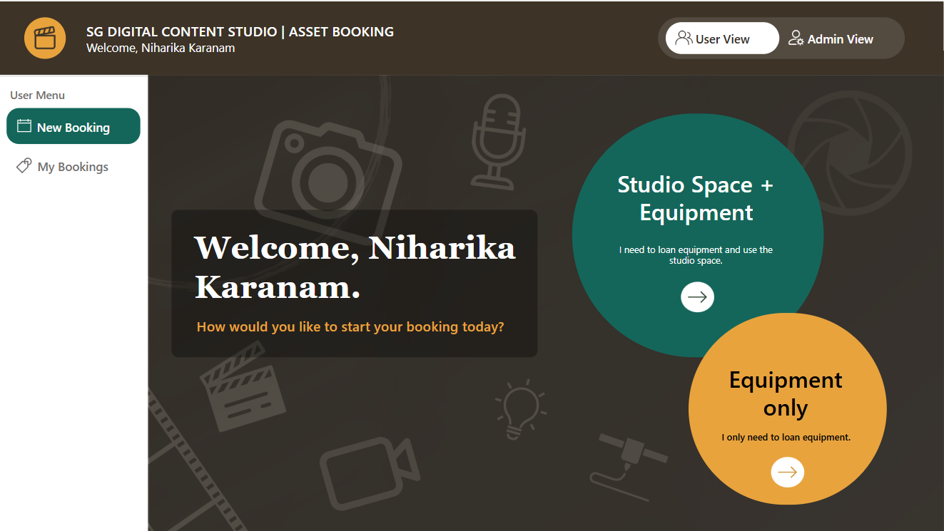
REDESIGN
New landing page
Both booking options are on the landing page.
A landing page gives the app a more bespoke look.
Uses the Nestlé brown theme so it feels on brand.
Hover backing on the main options gives a shadow effect.
A more modern look overall.

Slide 10
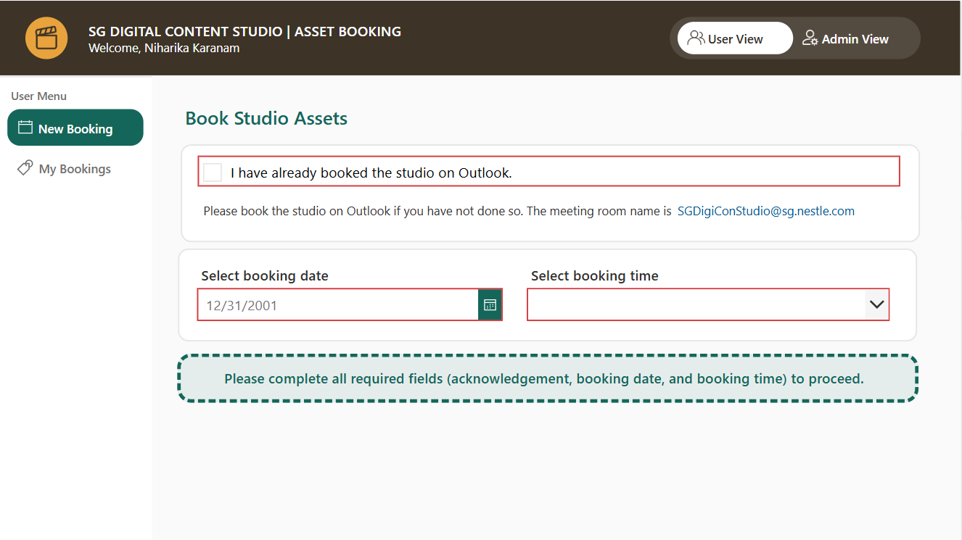
REDESIGN
Booking page: declaration, date and time
Users were missing the declaration and the booking date and time, and jumping straight to the assets. Those fields are now shown first, and the assets stay hidden until they are filled in.

Slide 11
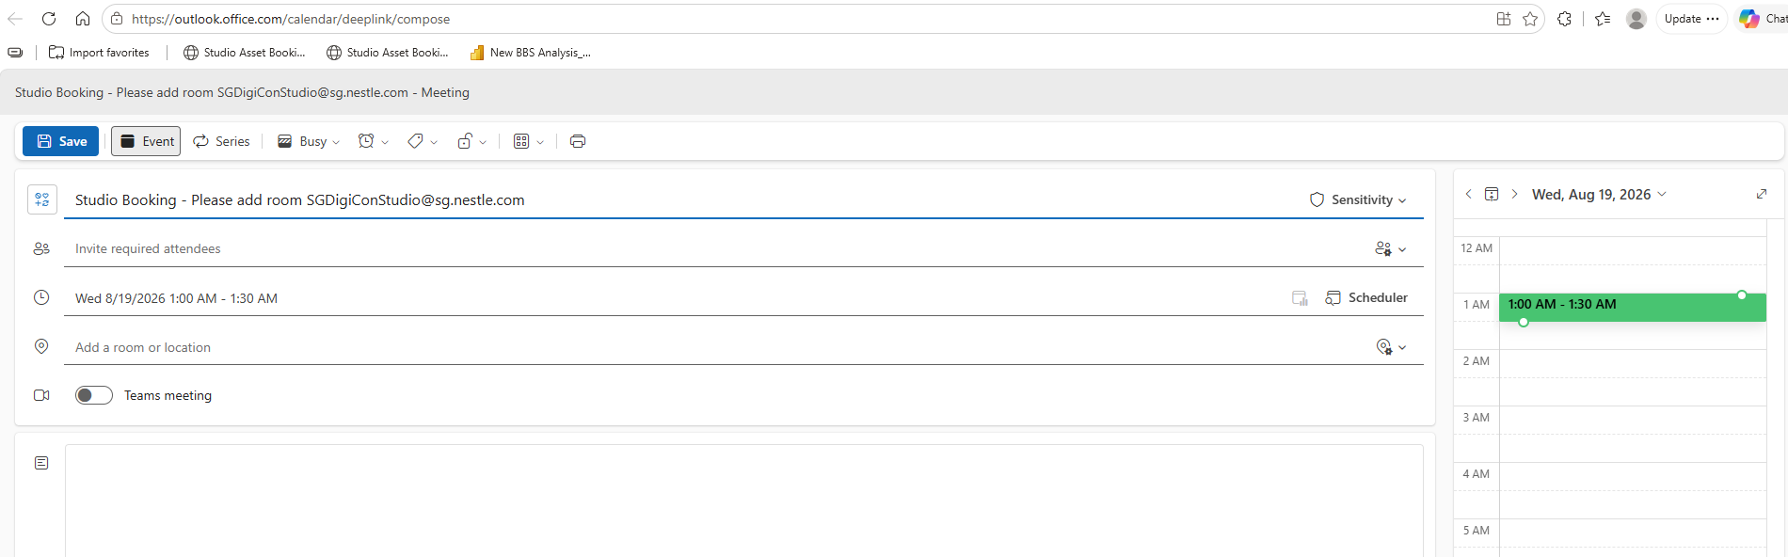
REDESIGN
Link to Outlook for studio space
For studio booking, the app links to the Outlook calendar with the studio email address, so the room and the attendee can be added in the subject field. This is the next best option, as I cannot automate the creation of a room booking or the pop-up of an Outlook event.

Slide 12
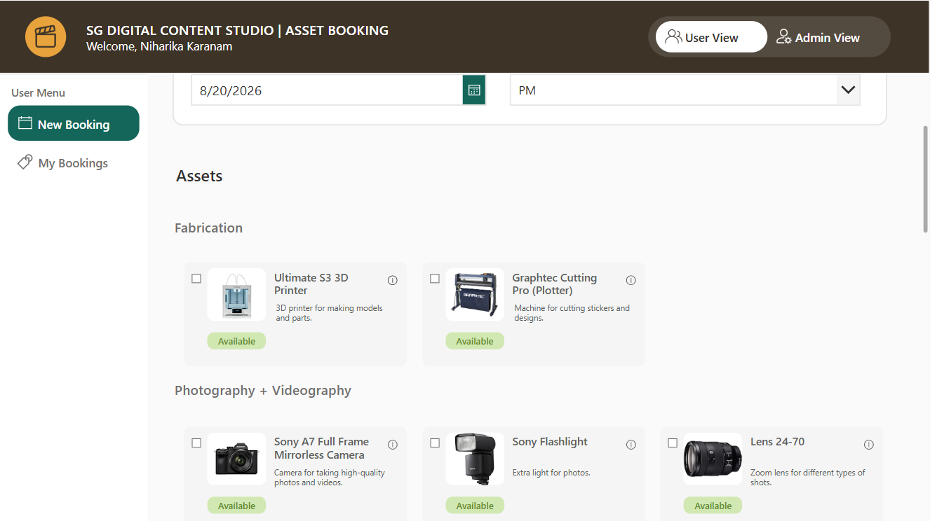
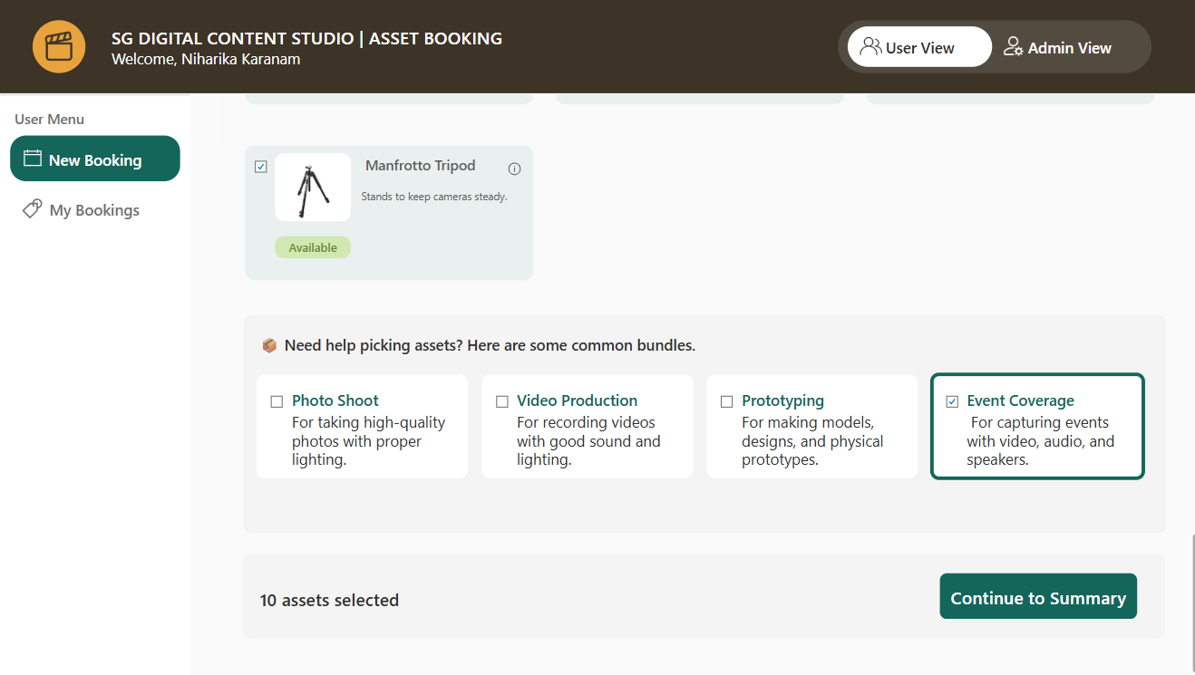
REDESIGN
Browsing assets and bundles
Assets by category
Bundles at the end
Assets are organised into categories, with thumbnail images and short descriptions. The whole list can be browsed without too much scrolling.
Bundles and the number of selected assets were moved to the bottom, for a better user flow after browsing the full list.

Slide 13
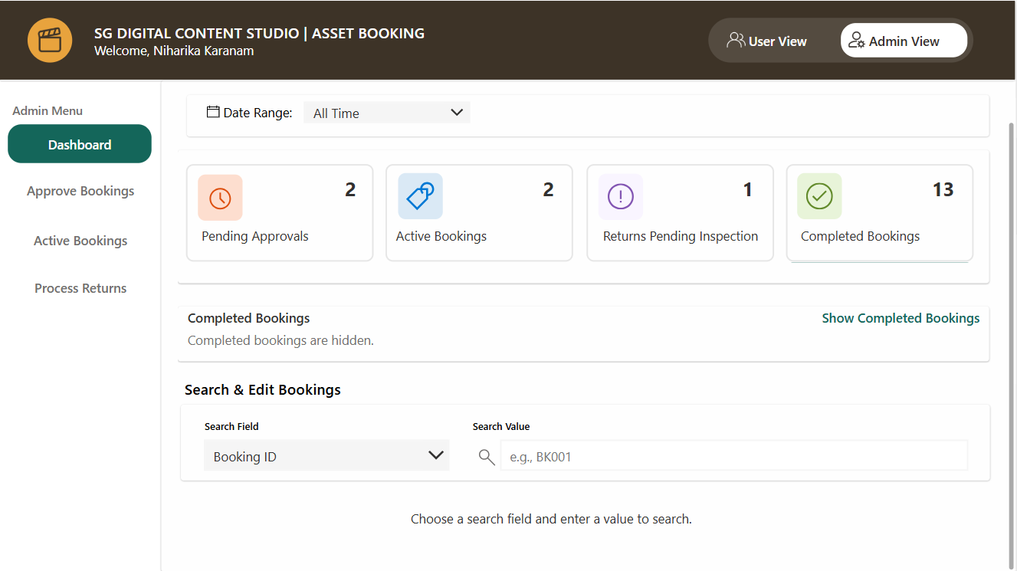
REDESIGN
Revised admin page
The admin page gives a dashboard view. Clicking a count goes to the matching page in the side panel.
Four screens: approve bookings, active bookings, process returns, and search and edit. No more two places to do the same action.

Slide 14
04
Data architecture
How can we ensure clean data for maintenance, and minimise changes at code level when the assets change?

Slide 15
DATA ARCHITECTURE
How the pieces fit together
One app, five lists, three flows, and the Microsoft services they reach.
Power Apps
Microsoft Lists
Power Automate
Services
User view
BookingRequest
Booking request flow
Outlook
Admin view
Asset
Approve, decline, cancel flow
Calendar
Approval and return screens
RecommendedBundles
Return photo upload flow
SharePoint
IssuesReturn
StudioAdmin
Built manually with Microsoft fx.
Typed columns, lookups between lists.
Triggered by list changes, or called from the app.
Assets, bundles and admins are lookups, so the app reads them at run time. Adding a camera or an admin is a new row in a list, not a change to the app.

Slide 16
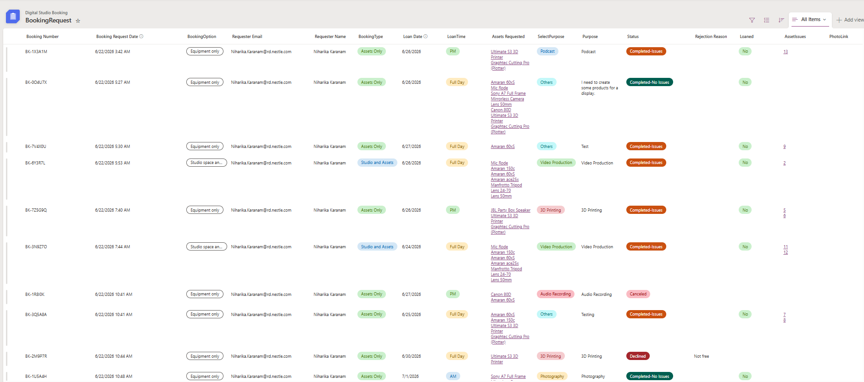
DATA
Booking Request List
The main list, with all the booking information.
Data types — Date type for dates, choice for categorical variables. This keeps the data clean and consistent.
Assets by lookup — Assets are a lookup from the Asset List, so the asset list stays dynamic as it is updated.
Updated by automation — The Status and Loaned columns are updated by Power Automate through the app actions.
Linked to issues — If there are problems in the return, the row hyperlinks to the entry in the Return Issues list.

Slide 17
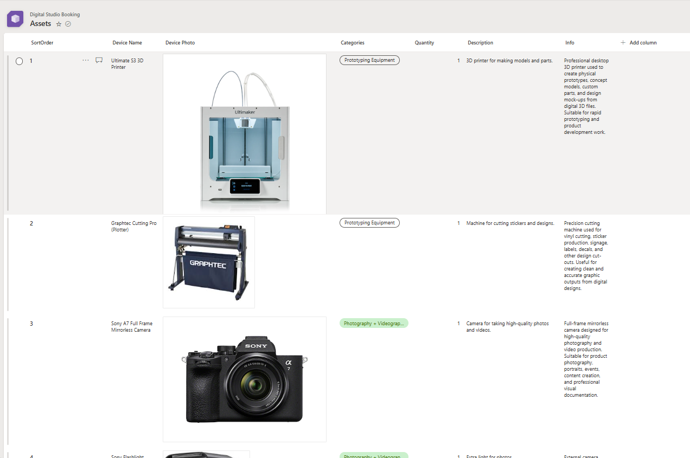
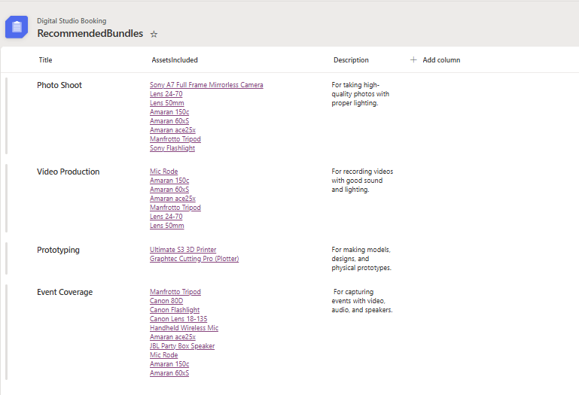
DATA
Asset List and RecommendedBundles List
Four categories, no code changes
Four bundles, built from lookups
Assets are populated in Power Apps according to their category. A new asset only has to be added as a new entry in the right category, and it appears in the app and in the whole booking process automatically.
The assets in each bundle are a lookup type, so items can be added or removed as needed. A bundle can never point to an asset the studio no longer holds.

Slide 18
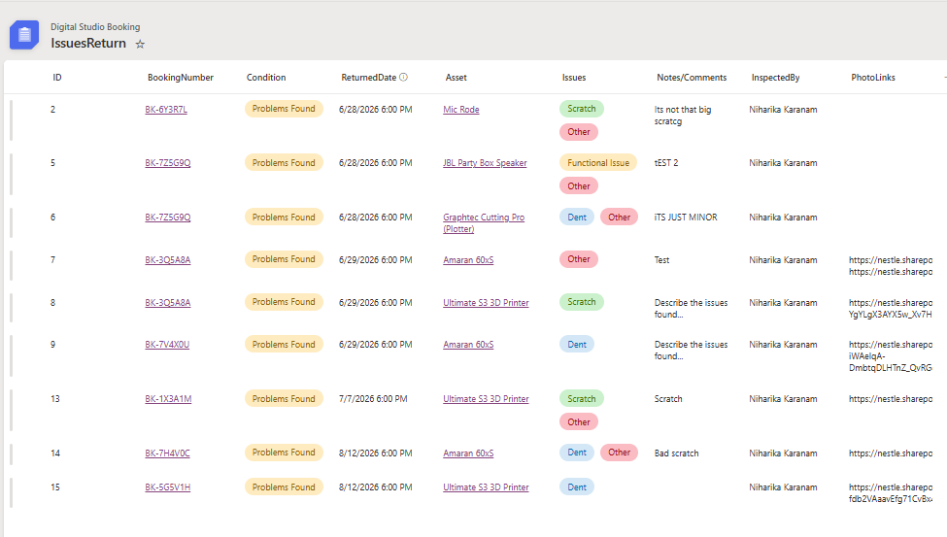
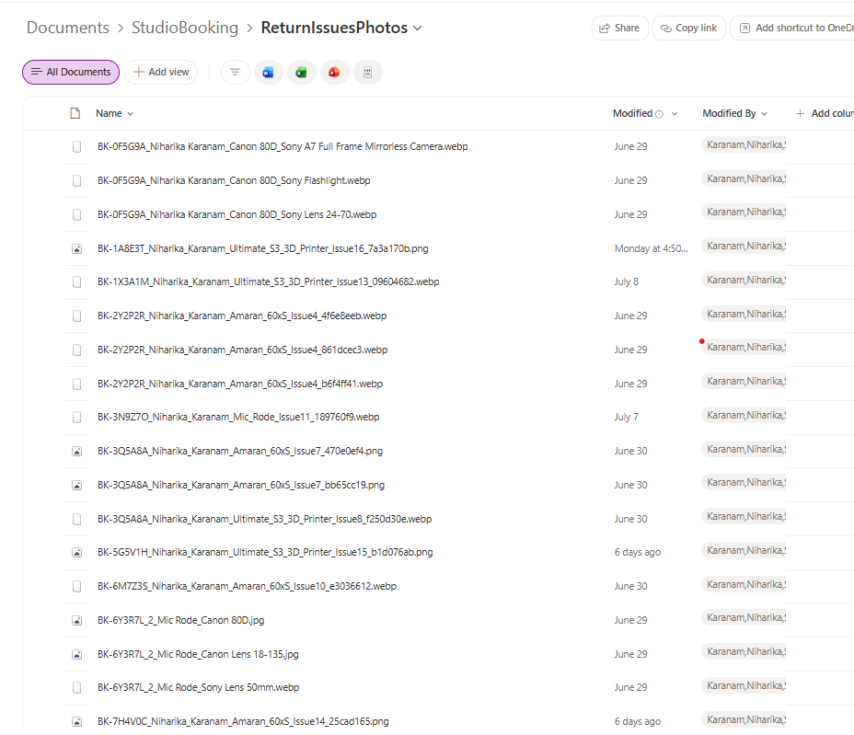
DATA
Return issues and damage photos
Only returns with issues are recorded. An entry for every asset with no issue would be repetitive.
IssuesReturn List
Photos named and filed automatically
Linked to the Booking Request list through the AssetIssues column. Contains choices of common issues, notes, and links to the SharePoint folder with images of the damage.
The app names each file with the booking number, user name and asset name, uploads it to the shared folder, and saves the link in the list. No manual renaming.

Slide 19
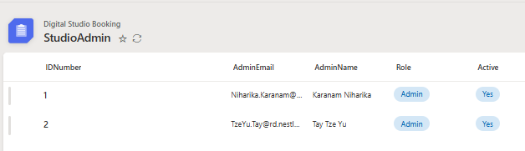
DATA
StudioAdmin List
Only people on the StudioAdmin list can switch from the user view to the admin view.
Only they can see the admin tab in the app.
Adding or removing an admin is a new row in this list. It does not require any change to the app.

Slide 20
05
Power Automate
Three flows that carry the booking from request to return, and tell everyone what has happened.

Slide 21
AUTOMATION
The booking lifecycle
What a person does, and what the system does in response.
REQUEST
REVIEW
DECISION
COLLECTION
RETURN
Person
The user selects the booking date, time slot and assets, then submits the request.
The admin checks what has been requested on the approval screen.
The admin approves or declines. The user can still cancel their own booking.
The admin issues the asset and marks it as loaned in the app.
The admin inspects the asset and processes the return.
System
Confirmation email to the user, notification email to the studio admin.
Booking status held in the BookingRequest list.
Approval email and calendar invite, or the decline or cancellation email.
The Loaned column is updated, so the asset shows as out on loan.
Issue logged in IssuesReturn. Flow 3 files the photo and returns its link.
Nothing in the bottom row needs a person to remember it.

Slide 22
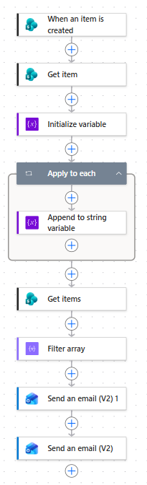
AUTOMATION
Flow 1 — Booking request
Triggered when a new item is created in the BookingRequest list.
When an item is created
Trigger. Fires on a new booking request.
The user knows immediately that the request was received.
The admin does not have to watch the portal for new bookings.
Both emails go to and from the studio address, so the main inbox stays clear.
Get item
Reads the full record for that booking.
Initialize variable
Prepares a string to hold the asset names.
Apply to each
Loops the requested assets and appends each name.
Get items and Filter array
Looks up the studio admins to address the notification.
Send an email (V2) ×2
One email to the user, one to the studio admin.
In Power Automate

Slide 23
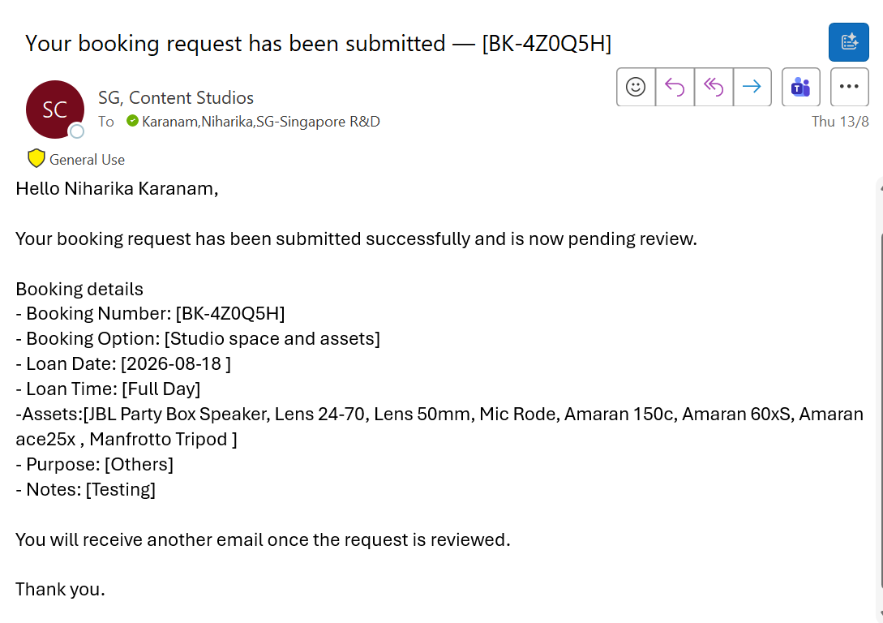
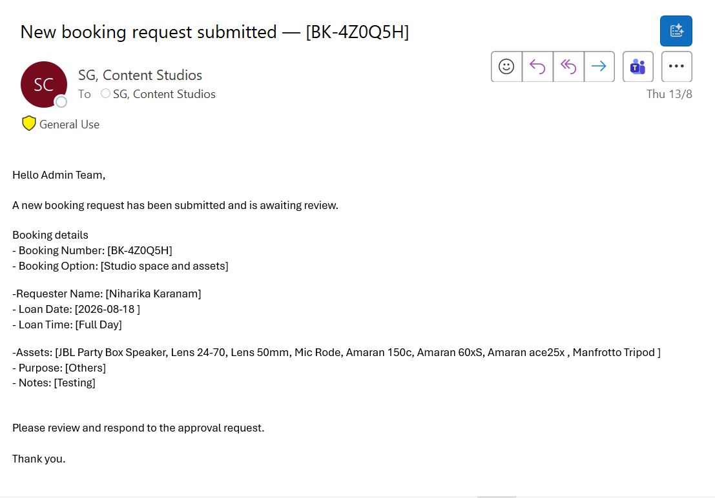
AUTOMATION
Emails sent at request
To the user — request received, pending review
To the studio admin — a request is waiting
Both emails list the booking number, option, date, time slot, assets, purpose and notes, so neither side has to open the app to see what was requested.

Slide 24
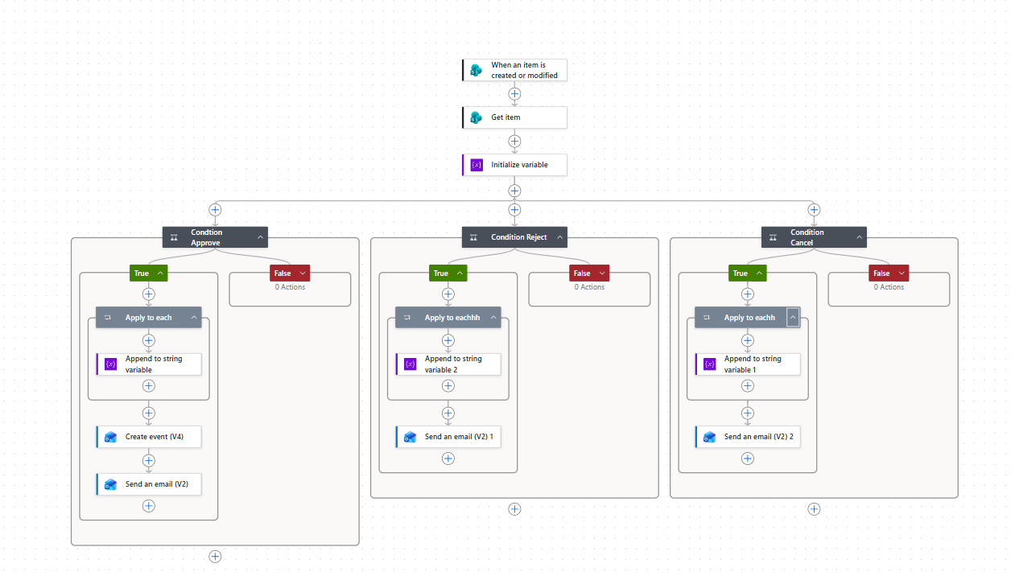
AUTOMATION
Flow 2 — Approve, decline, cancel
Triggered when a booking item is created or modified. Three conditions on the booking status.
Condition: Approve
Sends the approval email and creates a calendar event for the user and the studio.
Condition: Reject
Sends the decline email, including the reason given by the admin.
Condition: Cancel
Sends the cancellation email when the user cancels their own booking.
In Power Automate
Each branch builds the asset list into a string before the email is sent, so the message lists exactly what was booked. Changing the status is the only thing that has to happen.

Slide 25
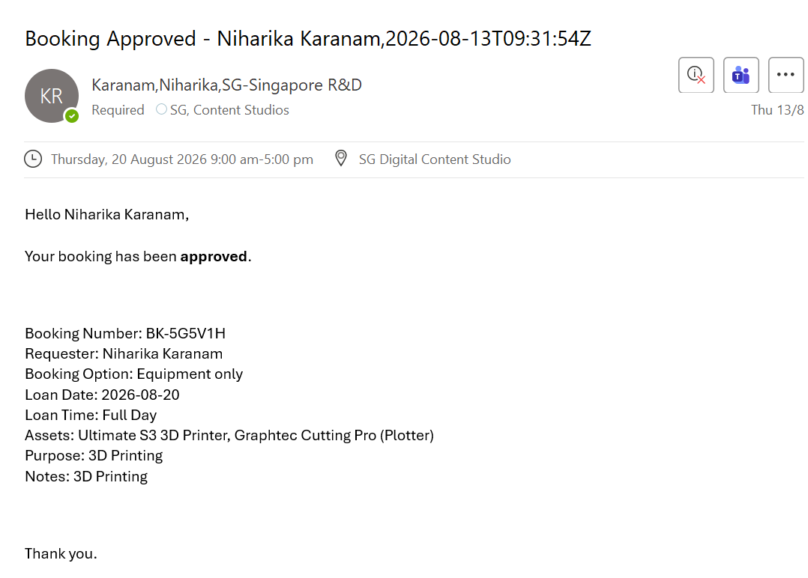
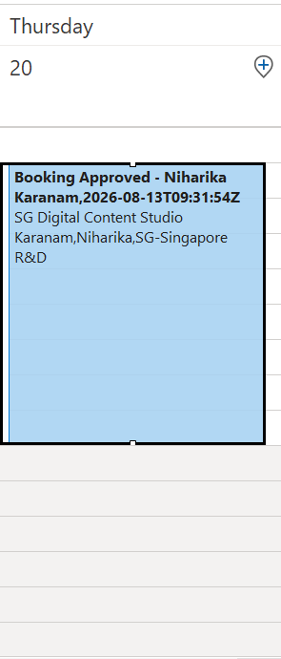
AUTOMATION
Approved: email and calendar invite
Calendar invite
The invite is created for both the user and the studio, so an approved booking shows up in both calendars without anyone adding it.
Approval email to the user

Slide 26
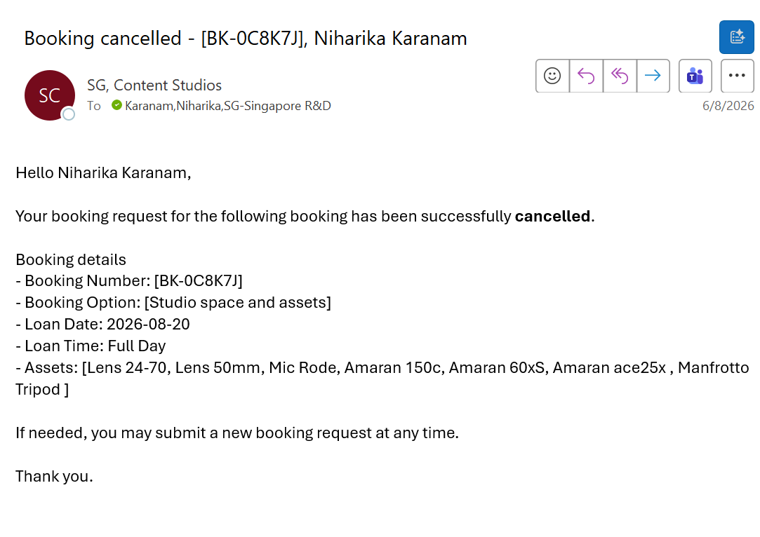
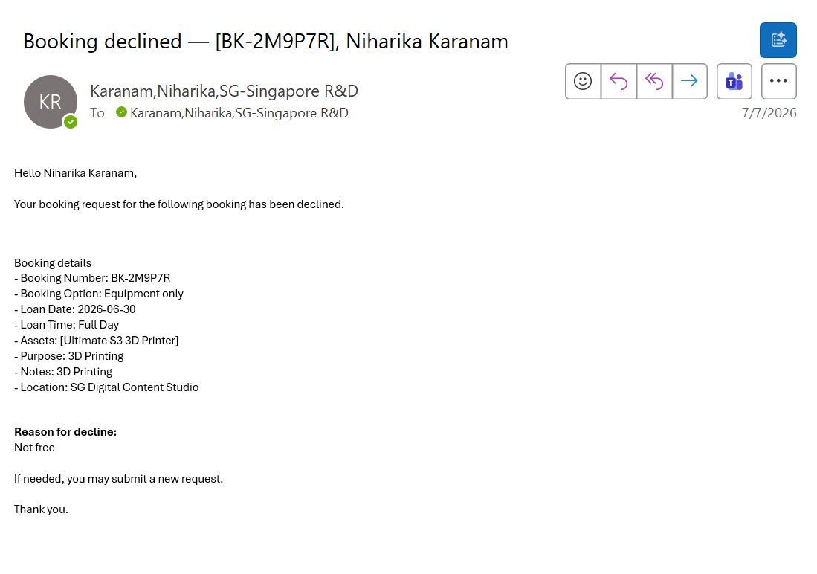
AUTOMATION
Cancelled and declined
Cancelled by the user
Declined by the admin, with the reason included
Every state the booking can reach sends a message. There is no outcome the user has to chase.

Slide 27
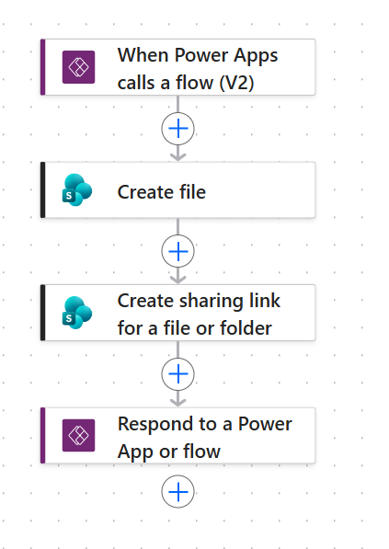
AUTOMATION
Flow 3 — Return photos
Called from Power Apps when the admin records a damaged asset on return.
When Power Apps calls a flow (V2)
Trigger. The app calls the flow with the image and the naming details.
Create file
Writes the image into the shared SharePoint folder, named with the booking number, user name and asset name.
Create sharing link for a file or folder
Generates a link to the file that other people can open.
Respond to a Power App or flow
Returns the link to the app, which saves it into the IssuesReturn entry.
In Power Automate
The result in the SharePoint folder
Every file arrives already named, so there is no guessing which photo belongs to which claim and no renaming by hand. Only returns with an issue reach this flow — an asset that comes back fine just completes the booking.

Slide 28
AUTOMATION
What fires, and when
The full set of automated actions in one view.
Event | Trigger | Who is notified | What else happens
Booking submitted | New item in BookingRequest | User and studio admin | Request held as pending
Booking approved | Booking status changed to approved | User | Calendar invite created for user and studio
Booking declined | Booking status changed to declined | User | Reason for decline included in the email
Booking cancelled | Cancelled by the user in the app | User | Booking marked as cancelled
Asset issued | Admin marks the asset as loaned | — | Loaned column updated in BookingRequest
Return with an issue | Return processed with an issue | — | Entry in IssuesReturn; Flow 3 files the photo and returns its link
Every one of these used to be something a person had to remember to send, create or file.
Notes:
Check this table against the live flows before presenting, in case any branch changed.

Slide 29
06
Interaction prototype
A live React/Vercel build tests the requester and administrator flows before operational implementation.
Notes:
Source: https://www.karanamniha.xyz/case-study-studio-assets.html
Live prototype: https://studioassetbookingsystem.vercel.app
Portfolio repository checked locally at commit 9bc256bdc9a74e12e81efc4a6f5ec190b7a8a5eb. The public GitHub URL returned 404 during review.

Slide 30
DEVELOPMENT
Prototype and production design
The prototype validates interactions. The operational design uses the organisation’s Microsoft 365 stack.
LIVE INTERACTION PROTOTYPE
INTENDED OPERATIONAL IMPLEMENTATION
React + Vercel
Microsoft 365 service
Used to test the booking path, navigation, state changes, requester visibility and administrator workflows through a deployable interaction model.
Power Apps supports requester and administrator interactions. Microsoft Lists holds booking and asset states. SharePoint stores evidence and files. Power Automate handles confirmations, approvals and reminders.
Development effort covered interaction prototyping, service states, data structure, workflow logic, automation conditions and exception handling.
Notes:
Source: https://www.karanamniha.xyz/case-study-studio-assets.html
Source file: portfolio_repo/case-study-studio-assets.html, verified against origin/main with no Studio case-study differences on the checked branch.

Slide 31
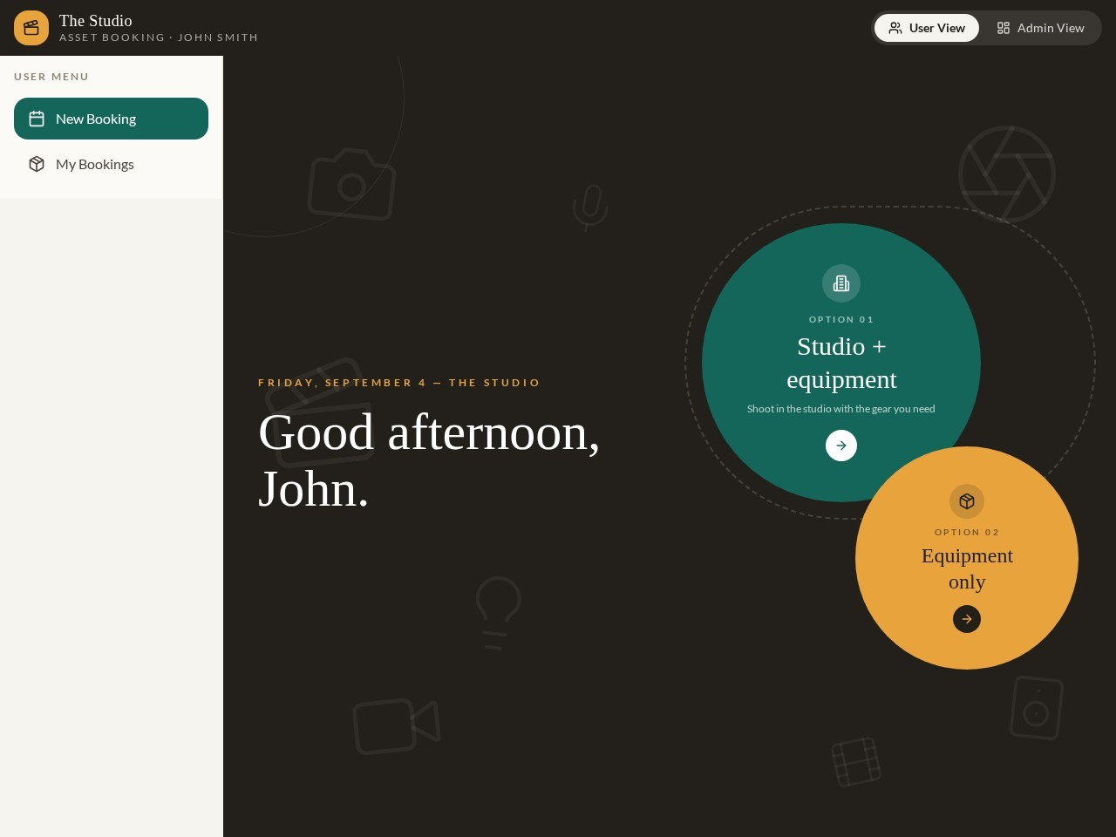
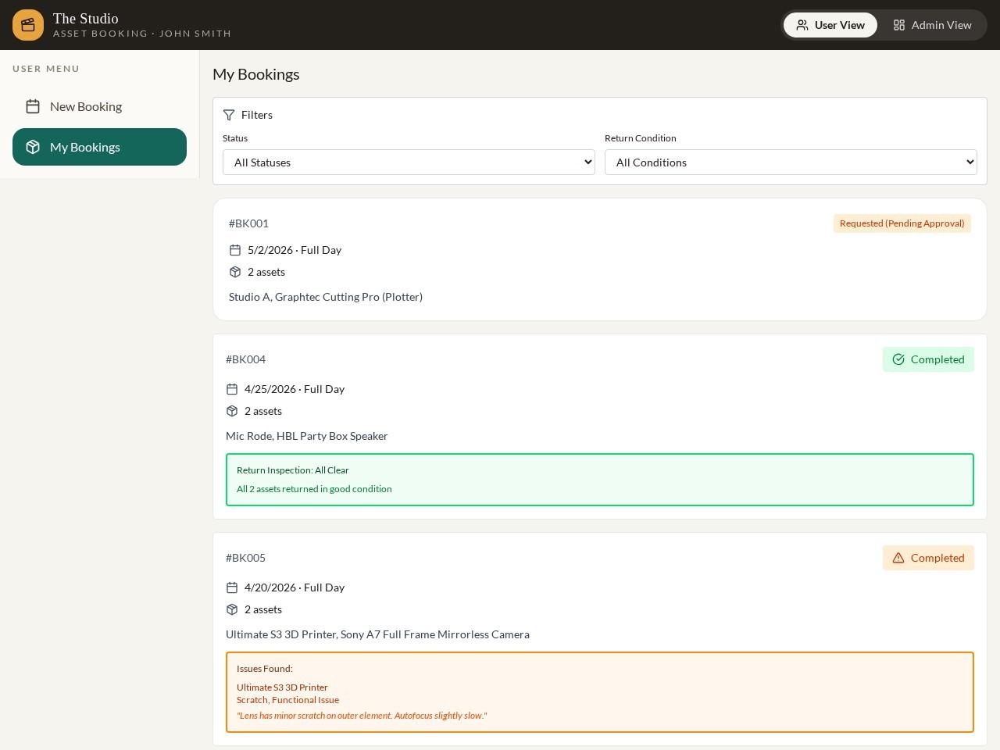
PROTOTYPE SCREENS
Requester journey
The booking entry keeps the first choice simple, while My Bookings makes status visible without another follow-up.
Choose the booking type
See booking status and dates
Notes:
Screenshots captured from the deployed interaction prototype through the case-study page.
Source: https://www.karanamniha.xyz/case-study-studio-assets.html

Slide 32
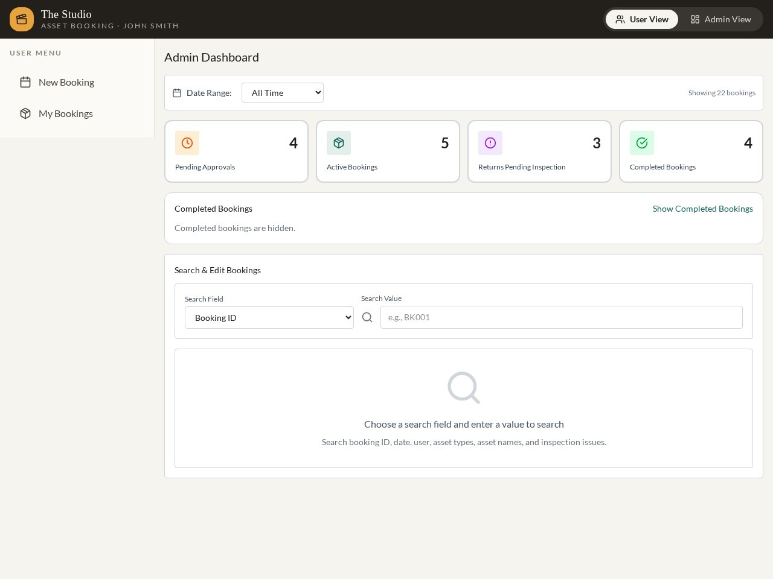
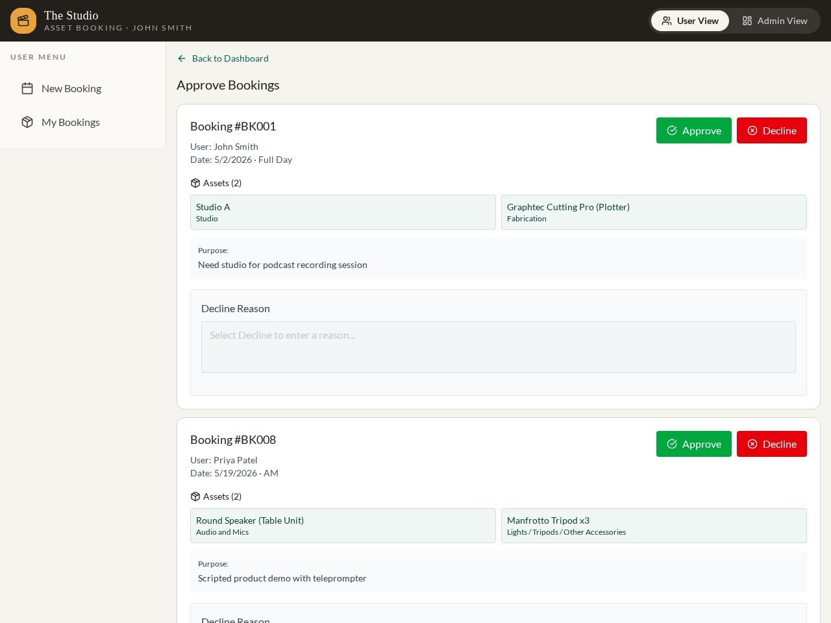
PROTOTYPE SCREENS
Administrator workflow
The dashboard exposes workload and the management view turns approval decisions into a visible queue.
Operational overview
Approval and status management
Notes:
Screenshots captured from the deployed interaction prototype through the case-study page.
Source: https://www.karanamniha.xyz/case-study-studio-assets.html

Slide 33
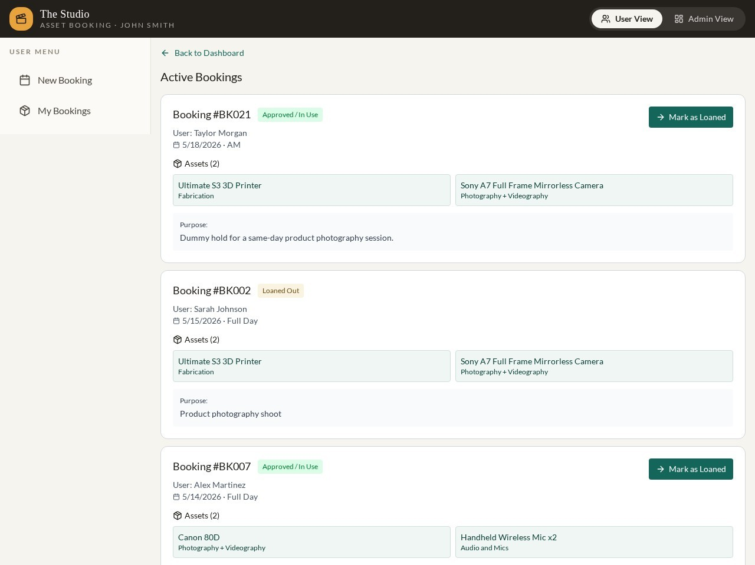
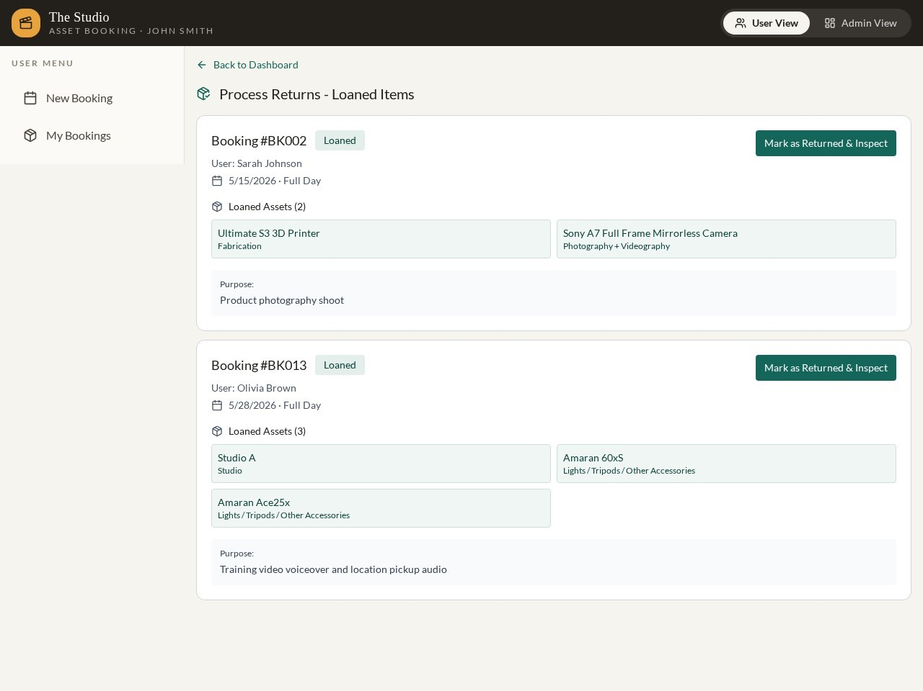
PROTOTYPE SCREENS
Active loans and returns
Booking remains traceable after approval, including equipment currently out and return inspection work.
Track equipment currently out
Document return and inspection work
Notes:
Screenshots captured from the deployed interaction prototype through the case-study page.
Source: https://www.karanamniha.xyz/case-study-studio-assets.html

Slide 34
OUTCOME
Operational visibility and validation
The redesigned service creates shared states and evidence. Business impact still needs measurement in production.
REQUESTER CLARITY
ADMIN CONTROL
TRACEABILITY
A visible booking path
Work becomes a queue
One lifecycle record
Employees can check availability, submit relevant details and see progress without relying on informal messages.
Approvals, active loans and return inspections become manageable states instead of hidden follow-up work.
Structured data, SharePoint evidence and automated messages create a clearer operational history.
MEASURES TO VALIDATE
Booking turnaround, manual follow-ups, conflicting requests, overdue returns and condition issues
Notes:
No productivity percentages are claimed because the case study does not provide validated production measurements.
Source: https://www.karanamniha.xyz/case-study-studio-assets.html

Slide 35
SUMMARY
What the project involved
UX and design
Data and automation
Build
Mapped the current process and set the features the app needed.
Built a testable prototype before any of the real app existed.
Ran four rounds of user testing and redesigned from the findings.
Landing page, progressive disclosure, and a consolidated admin view.
Designed five Microsoft Lists with typed columns and lookups.
Built three Power Automate flows covering request, approval, decline, cancellation and return photos.
Automated emails, calendar invites, file naming and SharePoint uploads.
Structured returns so issues are recorded by exception.
Prototyped in Figma, then GitHub, Codex and Claude.
Built the live app manually in Power Apps with Microsoft fx.
Admin access controlled by a list rather than in the app.
Designed so new assets and admins need no change to the app.

Slide 36
NEXT
Possible improvements
Areas to build on, using the data the app now collects.
Usage analysis
Asset purchasing
Room booking API
Use the booking data to look at demand, peak periods and the most requested assets.
Use unmet demand and bundle patterns to guide what the studio buys next.
If access becomes available, remove the manual Outlook step for studio space.
Asset condition history
Prompt-built apps
Wider use
Track issues per asset over time to spot equipment that keeps coming back damaged.
Revisit AI-assisted building in Power Apps if organisation policy allows it.
The same pattern could work for any shared resource in the business.
Notes:
Edit these to match what you want to propose.

Slide 37
WHAT CHANGED
Space in Outlook, assets by email
One app for space, assets, or both
No shared view of what the studio has
A browsable asset list by category, with bundles
Requests chased by hand on both sides
Request, approval, decline and cancellation emails sent automatically
Returns inspected informally, recorded nowhere
Returns with issues documented, photos named and filed
No data on usage
Every booking recorded as data the studio can use
Thank you
Niharika Karanam

